Slide 1

Improving Business Processes

Slide 3


Andrew Binns
Microsoft
Western Europe Project and Visio Specialist
http://www.planmanagedelivermicrosoftproject.com/es-es
http://Microsoft.com/Visio
http://blogs.office.com/visio/
+44 777 33 713 66, v-abinns@Microsoft.com

Slide 5
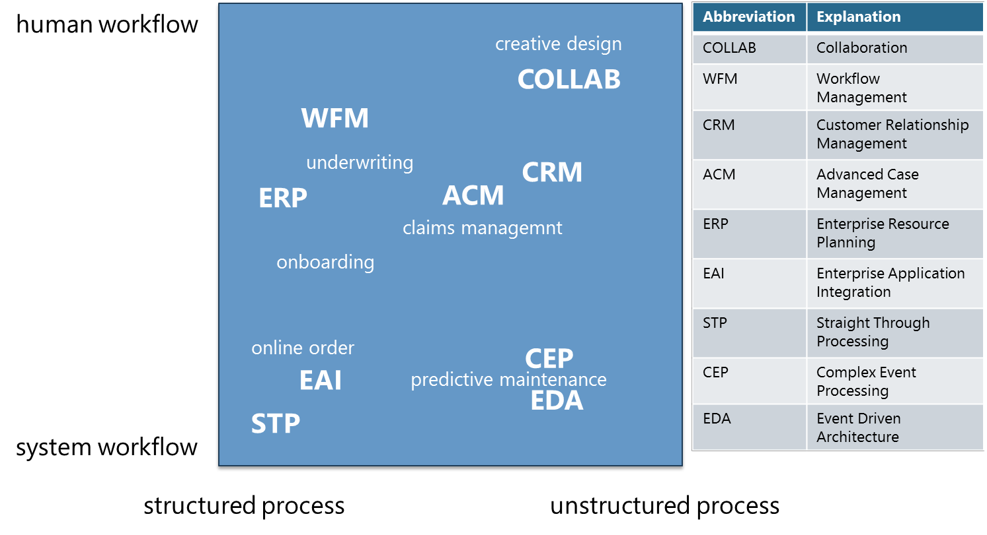
Modern Business Applications
Notes:
Structured processes: These are processes that are (relatively) fixed in stone, executed in the same way every time. For example invoicing, ordering, etc. are usually structured processes.
Unstructured processes: These kind of processes usually involve collaboration between people and is (slightly) different every time. Examples are the sales process and consulting services.

Slide 6
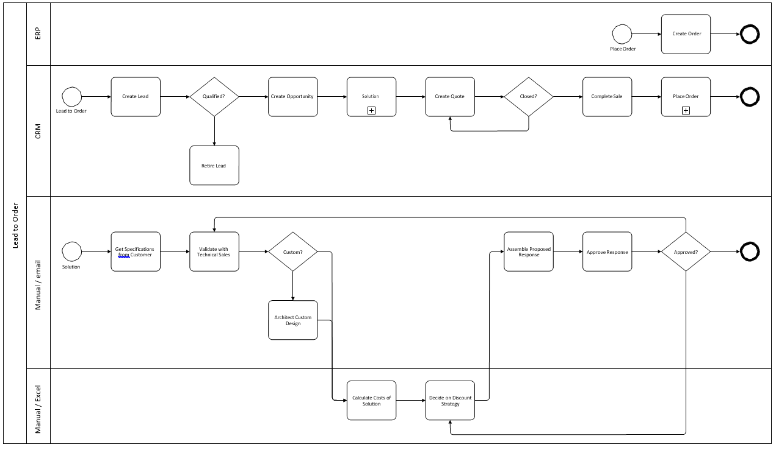
Business Process Mapping
Notes:
A traditional Business Process Mapping
When going for the customizing route, it is always vital to ask this question: “Will the core functionality of the application be compromised when adding these features and functionality?”. Misuse of applications need to be prevented; for example if a CRM applications is used to implement functionality that is clearly not in the CRM realm. This will result in applications that are hard to manage and maintain.
When going the Modern Business Apps route for implementing new or changed business processes, full flexibility to adjust them to the business needs and being able to continuously improve them becomes available. That is the real advantage: being able to measure (through BI) and thus get continuous feedback and fine-tune the processes accordingly

Slide 7

Process Improvement Strategies
Business Process Operation

Slide 8
Improving Business Processes
Capture
Standardize
Automate
Continuous improvement
Notes:
Capture process: The first thing that’s absolutely vital to do is to capture the process in a modeling tool. Sometimes the customer will have (Visio) diagrams of processes,
sometimes they don’t. In the latter case, processes are “documented” inside peoples heads and need to be extracted and put “on paper”. Visio can be used for this. The business- or process analyst together with the consultant will draw the diagrams and validate them together. Now the process is documented and the next step can take place. In this stage measures, dimensions and SLA’s are defined to be able to track the process.
Standardize process: Next step is to figure out which parts of the process that has been documented in the previous step, can be standardized by implementing part(s) of the flow as human workflows in the collaboration environment.
Automate process: Parts of the process that can be fully automated are identified here. These parts often have to do with integration of all kinds of data and (sub)processes in existing applications. These processes and the integration needs can be orchestrated and automated in the (Federated) Enterprise Service Bus.
Continuous improvement of process: When deploying parts of the process to the collaboration environment (the human workflow pieces) and parts to the ESB (the system workflow a.k.a. orchestration pieces), the BAM observation model belonging to this process needs to be deployed. During process execution, the platform will capture runtime information and make it available through a dashboard. Examples of these dashboards can be found later in this document.

Slide 9
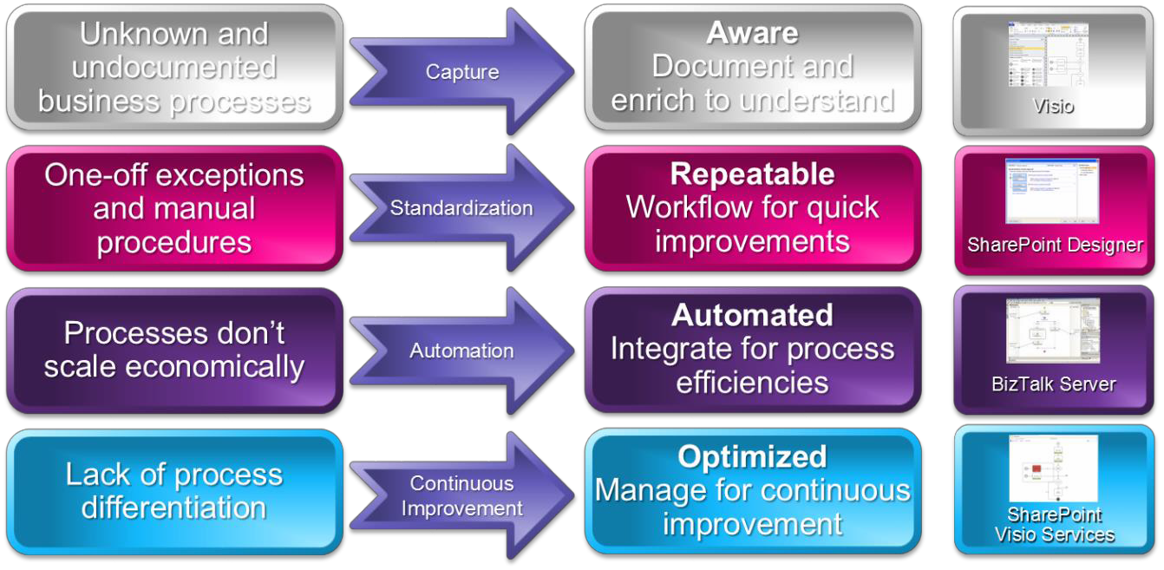
Building Excellence in Processes
Notes:
Capture process: The first thing that’s absolutely vital to do is to capture the process in a modeling tool. Sometimes the customer will have (Visio) diagrams of processes,
sometimes they don’t. In the latter case, processes are “documented” inside peoples heads and need to be extracted and put “on paper”. Visio can be used for this. The business- or process analyst together with the consultant will draw the diagrams and validate them together. Now the process is documented and the next step can take place. In this stage measures, dimensions and SLA’s are defined to be able to track the process.
Standardize process: Next step is to figure out which parts of the process that has been documented in the previous step, can be standardized by implementing part(s) of the flow as human workflows in the collaboration environment.
Automate process: Parts of the process that can be fully automated are identified here. These parts often have to do with integration of all kinds of data and (sub)processes in existing applications. These processes and the integration needs can be orchestrated and automated in the (Federated) Enterprise Service Bus.
Continuous improvement of process: When deploying parts of the process to the collaboration environment (the human workflow pieces) and parts to the ESB (the system workflow a.k.a. orchestration pieces), the BAM observation model belonging to this process needs to be deployed. During process execution, the platform will capture runtime information and make it available through a dashboard. Examples of these dashboards can be found later in this document.

Slide 10
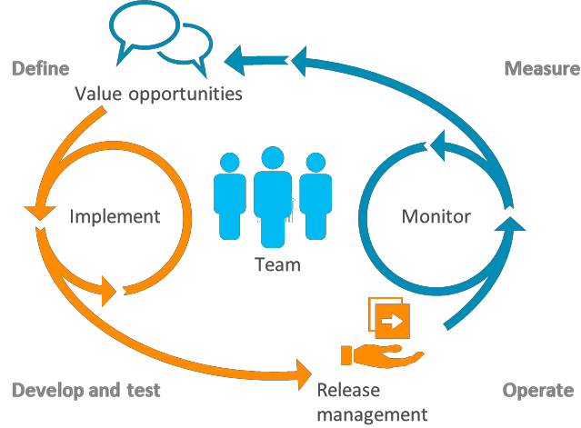
Business Process Development
Modeling processes and defining the business rules
Designing & developing processes
Deploying and running processes
Measuring and reporting process execution
Fine-tuning processes

Slide 11
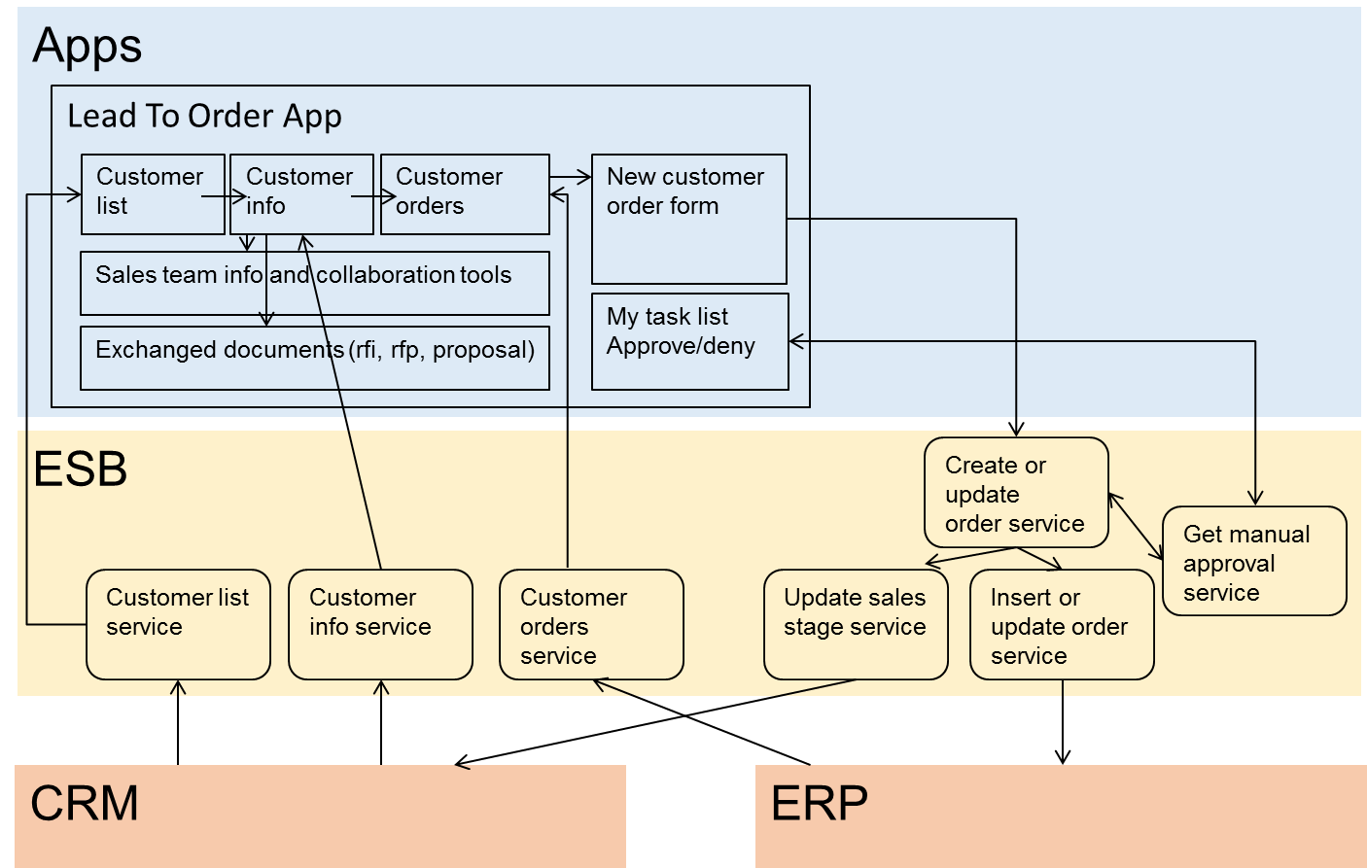
Enterprise Architecture
Notes:
Some parts of the process are supported by systems like a CRM and ERP, some parts of the process however are manually supported. In order to keep track of the whole process and benefit from the end-to-end monitoring of the process, these steps can be supported by e.g. SharePoint.
Both the the CRM and ERP systems provide the needed functionality through a web services interface. The ESB layer orchestrates the composite processes and guarantees robust transaction handling. The Apps consume these (composite) services and are hosted in a portal that can be exposed to various devices.

Slide 12
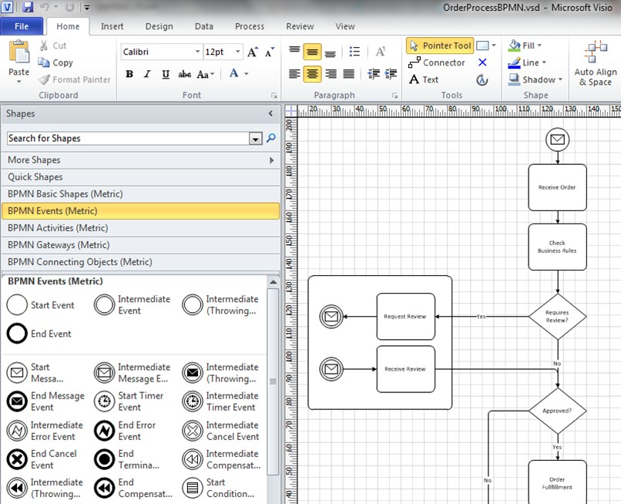
Model The process as a Composite Service
Notes:
Not just a drawing implementation. Process models are used for:
having a common model to understand the situation and to have a basis for discussion;
having an engine keep track of the current state of an instance;
reporting all kinds of business information related to the process.

Slide 13

A Quick Peak at the Technology

Slide 14
Technologies
Visio Pro (2013 or O365)
SharePoint
Workflow Server
SQL Server
Biztalk Server
Office 365
Excel
Outlook
Yammer
Skype for Business
Power BI
Notes:
SQL Server: The data platform that is used by most Microsoft Server products for data storage, but also for ETL a.k.a. data integration (SQL Integration Services) and BI (SQL Analysis Services and Reporting Services).
BizTalk Server: The integration middleware that is used to provide the means to implement an Enterprise Service Bus (ESB) to enable Service Oriented Architecture (SOA), Business To Business integration (B2B) and Application To Application Integration (A2A). It also provides the core facilities for Business Process Optimization (BPO), such as the Orchestration Engine, Business Activity Monitoring (BAM) and the Business Rule Engine (BRE).
SharePoint: The collaboration environment and ultimately, the central digital workplace to deliver Apps for a broad range of uses. This platform provides content management, collaboration (through team- and project sites and workflows) and search facilities. SharePoint also includes application services like Forms Services (to host and handle forms), Excel Services to host and share Excel reports and Visio Services to report BI information through dashboards.
Apart from the application platform, Office is the glue that ties everything together from an end- user perspective. The following Office products are important for Process Excellence:
Excel: Excel is used to define process milestones and other metering information in order to be able to configure BAM. Excel is also used to visualize runtime business activity information. With the new enhanced Power BI capabilities, all sort of business insights can be composed.
Visio: Modeling processes by means of BPMN (Business Process Model and Notation) can be done using Visio. The modeled business processes can be used to plot process metrics and render them in the browser (through SharePoint). This will give insight in process performance visually.
Outlook: Most people have their Outlook client open all day, because they need constant access to emails, calendar and tasks. Both email and tasks are frequently used in Process Excellence environments.
Use Yammer in the design of proceses and to discuss their development

Slide 15




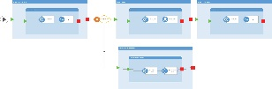
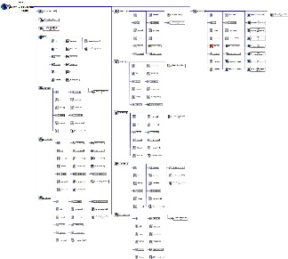

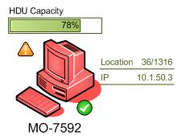
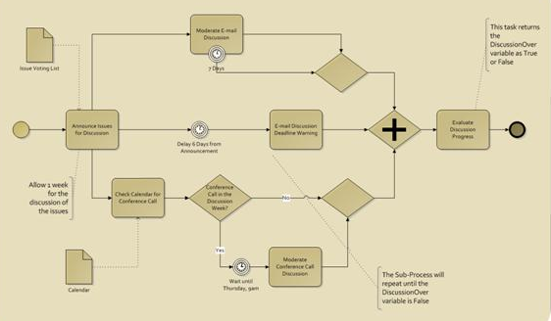
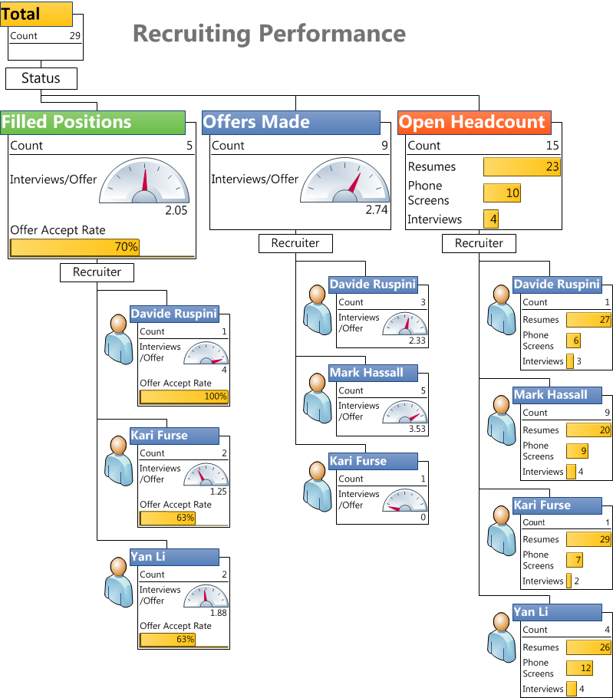
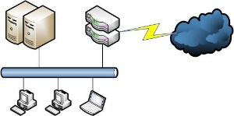
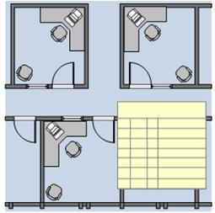
Microsoft Visio 2013 – What it does
Standard
Professional
Visio services
2. Publish
SharePoint
Designer
3. Update
Marketing
Import
Export
Schedules,
Timelines and
Project Gantt
1. Link to
external data
Mind maps /
brain storming
Export
Visio Workflow
Interrogate
SP and web sites
Organisation
charts
Flowcharts and
business mapping
Data graphics
(text, data bars, colour by value and icons)
BPMN, ‘Rules’ based diagrams and Checking
Networks and
rack cabinets
Pivot diagrams
Space planner, floor plans, scaling and layers
Co Authoring

Slide 16
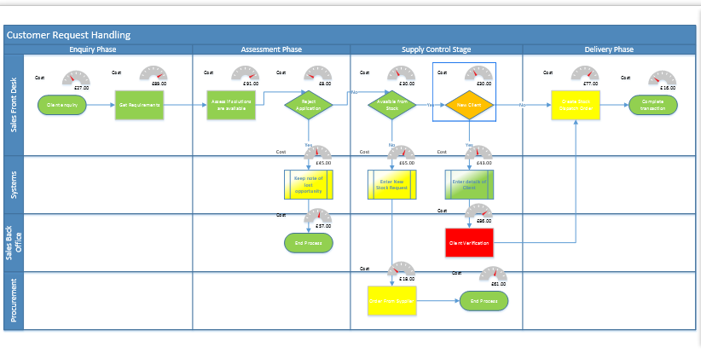
Build a Process Repository
Central Business Representation
Managed Process Change
Implementation
Process Objects
Version Management

Slide 17
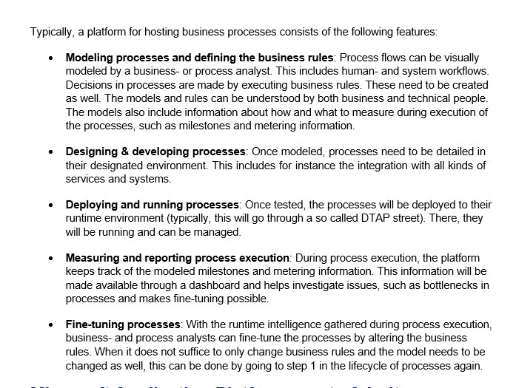
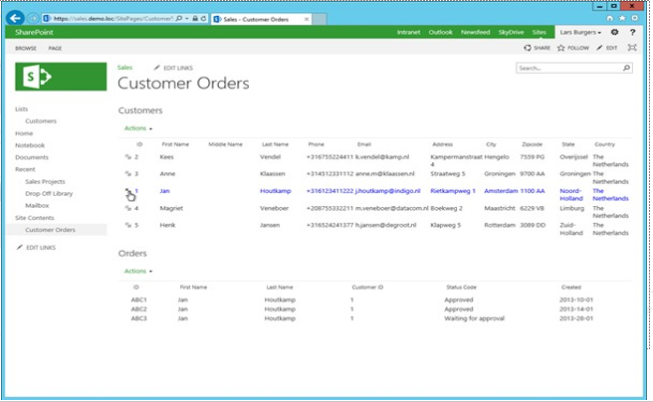
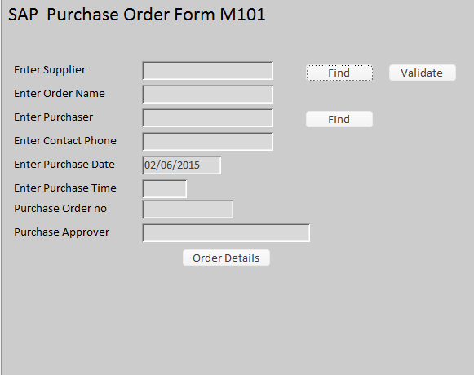
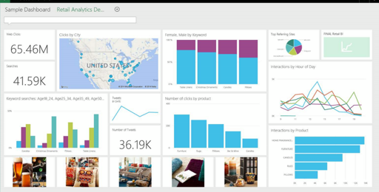

Use SharePoint’s Rich Functionality
Make Process Maps more interactive
Open Process Instructions
Click on a specific activity to….
View Transaction History
Open Relevant System form
e.g. SAP, Oracle
Access relevant reports
Watch Training Videos

Slide 18
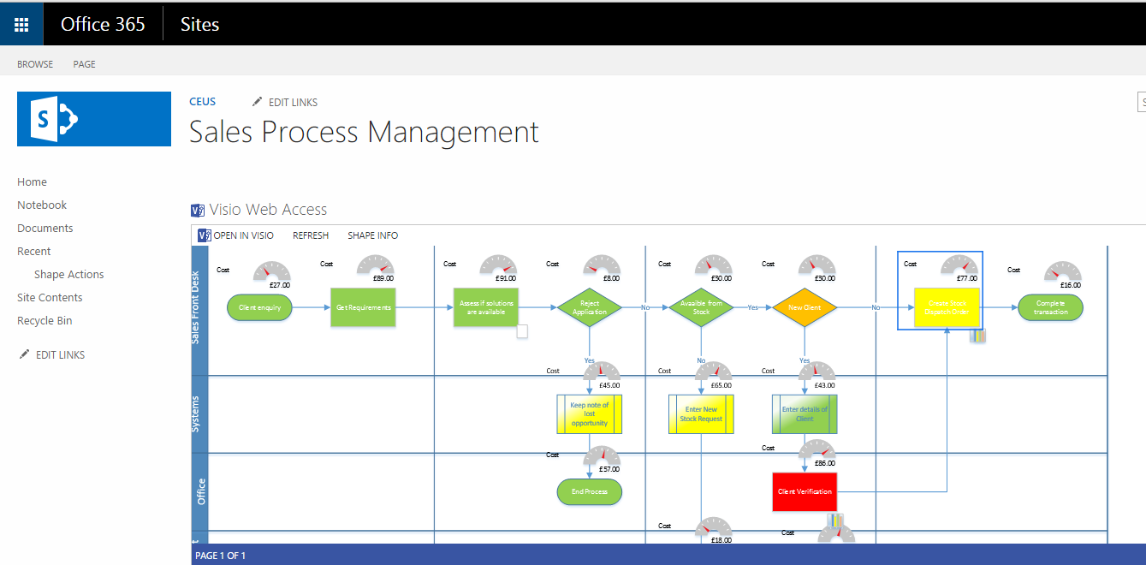
Business Processes Mapped!

Slide 19
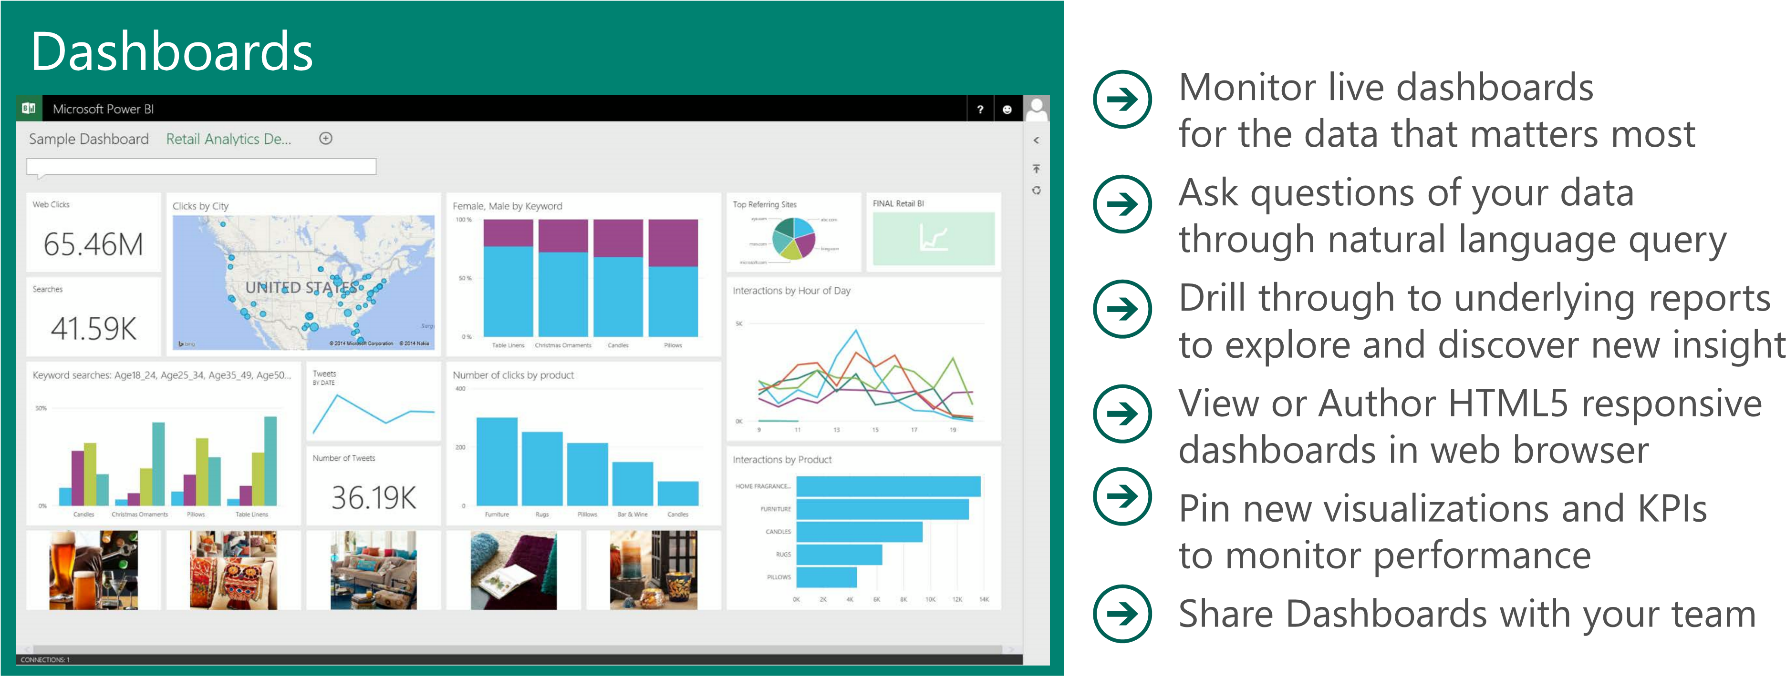
Click to Business Intelligence

Slide 20
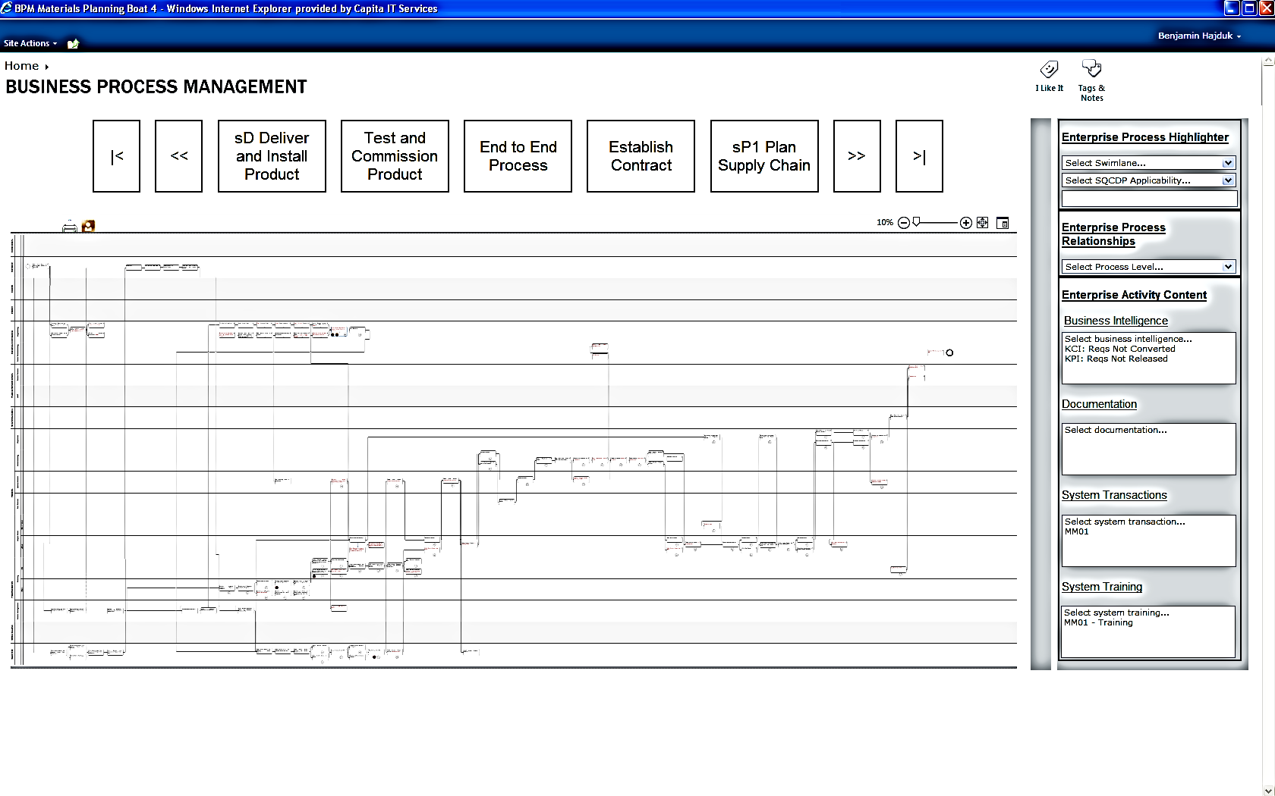
Business Process Re-engineering Case Study
Large Manufacturer, 5000 users
Wanted to consolidate 20 Systems, Improve SAP adoption
Features
End Point navigation
Click through to Docs
Click through to Operational System (e.g. SAP)
Operational System driven RAG indicators on each process
Reporting – linked to RAGs
Red-lining of process routes
Notes:
This is a solution that was created in about 4 months using 6 partner staff and 6 client staff. The cleint needed 300 Visio licences.

Slide 21
Optimise the Process Model
Use Risk Analysis to assess deviations from the norm
Use Monte Carlo Analysis to use large numbers
Identify optimal values of resources required for each process action
Calculate overall resource requirements for each Process map/Scenario
Accounts
Warehouse
Optimisation Modelling
ERP
CRM
e.g. Use Modelling and Risk Analysis
Perhaps use add-in with Excel

Slide 22
Technical Strategy

Slide 23
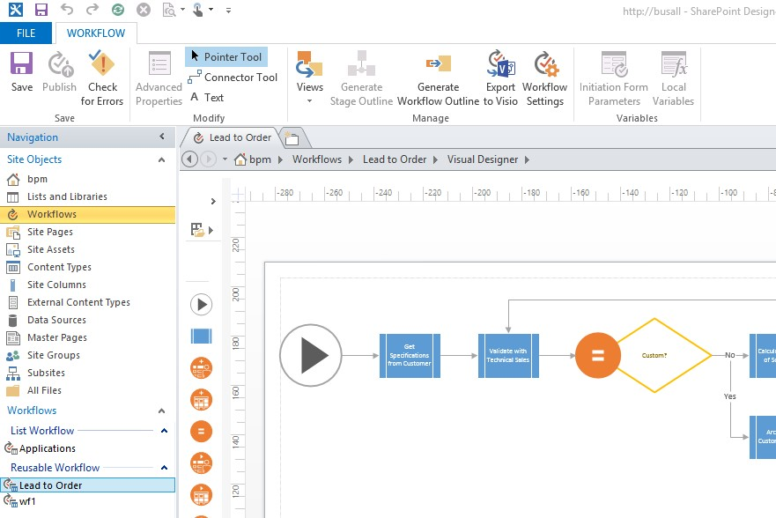
Create Human Workflows – Workflow Server
Or SharePoint Workflow!

Slide 24
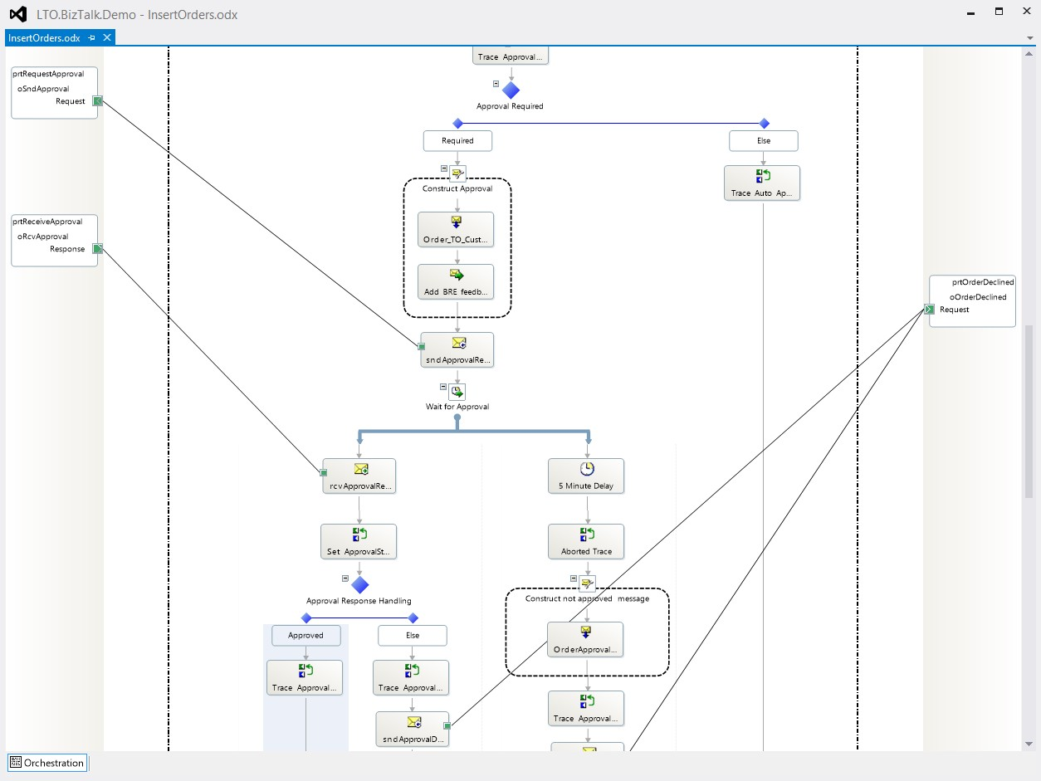
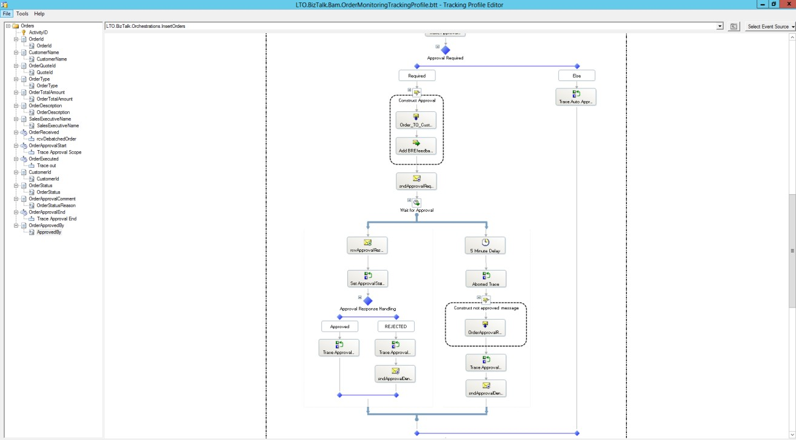
System Workflows
Using Biztalk to create:
mapped sequences
observation classes
Notes:
In the first stage of the process lifecycle the business- and/or process analyst decides what milestones and metering information is going to be of importance. In this stage BAM needs to be instructed how to capture that kind of information. This is done by using BizTalk’s Tracking Profile Editor. This tool looks like this:
Using the Tracking Profile Editor you can create the links between the information you want to capture according to the model and steps in the orchestration and elements in the exchanged
web services payloads (messages) by using drag-and-drop. Once this is deployed, BizTalk will automatically record all the right information according to the model.
BAM will also be exposed as web services. This is necessary for the integration of BAM in SharePoint Workflows. With the arrival of SharePoint 2013 it is possible to integrate web service invocation directly from within workflows. This comes in handy when there is a need to capture milestones that are steps in the human workflows. This is implemented by invoking the BAM web services exposed by BizTalk directly from within the workflow designer in SharePoint.

Slide 25
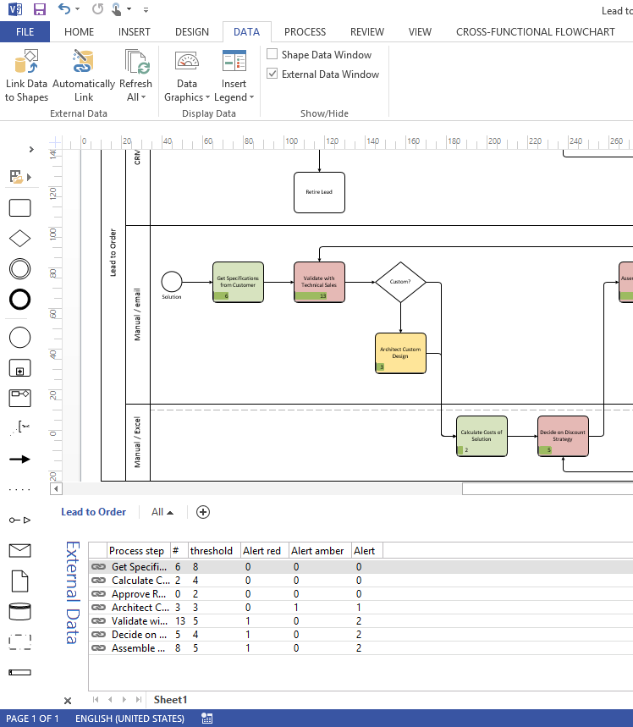
Create the Visio Dashboard
Use Data Linking to shapes
Use Data Graphics to expose the data

Slide 26
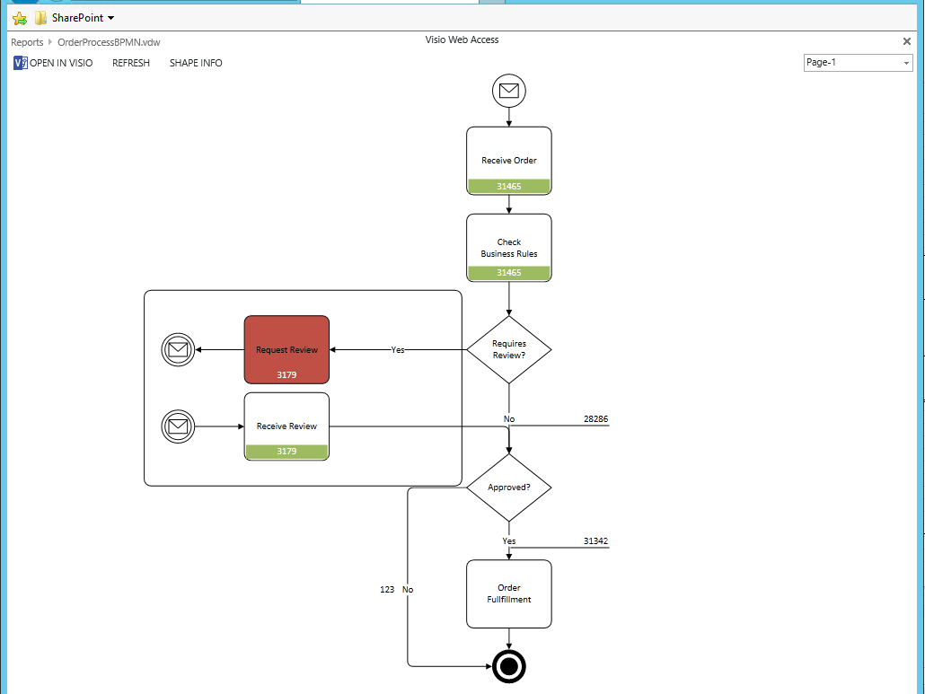
Operational Health Monitoring
Use Visio Data Graphics to provide:
Real Time data presentation
Real Time Issues using RAG performance criteria
Create drill downs to detailed process monitoring.
Notes:
Once configured and deployed, the platform can be managed and monitored in several ways at the various levels. For example, operational (health) monitoring can be accomplished through System Center Operations Manager (SCOM). For each server product, there are management packs that can be installed and configured. This will help monitor the health of the platform.
Apart from that, monitoring and management from a functional perspective is also very important. For this, SharePoint Central Administration, the BizTalk Administration Console and BAM (at this level used for Operations Monitoring) are important. These are the tools and features to manage your platform and to do end-to-end monitoring of information flowing through it.
Business- and process analysts can monitor the processes from a business perspective by means of Visio Services. The dashboard that has been set up in a previous step can now be used to get real-time insight in the process flows.

Slide 27
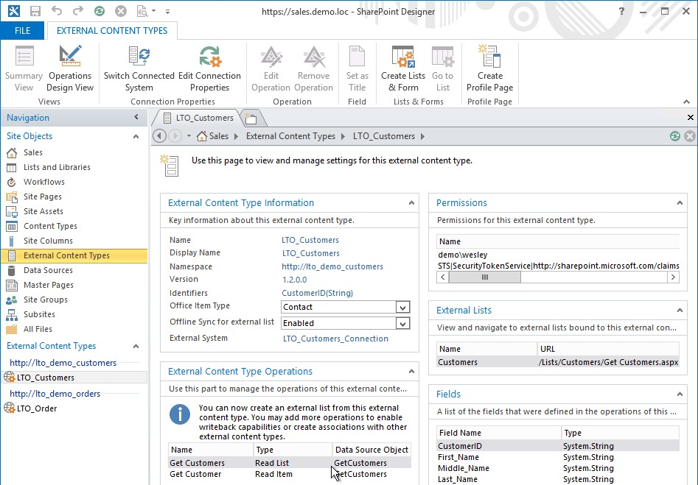
Link External Data In SharePoint
Use SharePoint Designer
Create External Content Types to expose external data

Slide 28
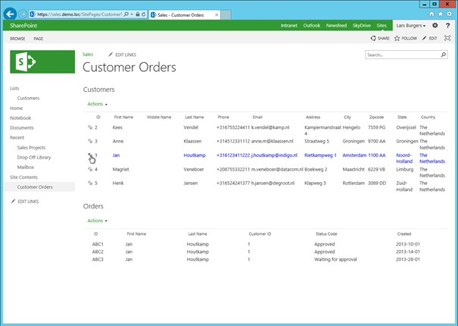
Link Data In SharePoint

Slide 29
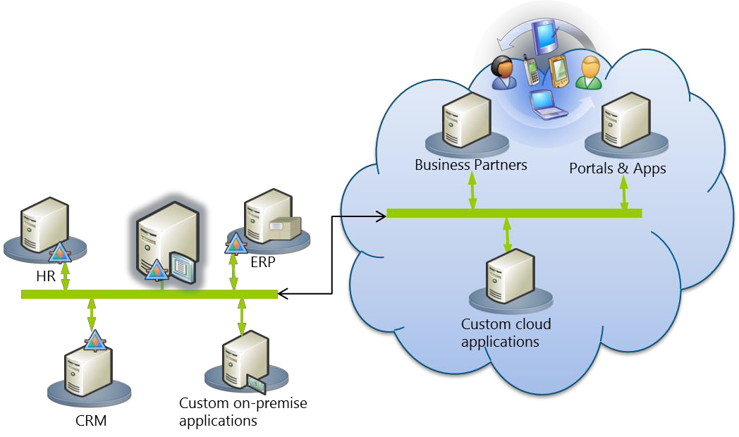
Hybrid Architectures
On Premise and Cloud connectivity

Slide 30
Hybrid Architecture - Data Integration
ERP
CRM
2-way Data Transfer
Visio Services
BizTalk
SharePoint
Microsoft Data Management Gateway
Power BI
Data Warehouse
SQL or Excel

Slide 31
Demo: Building Business Processes

Slide 33

Q&A

Slide 34
Andrew Binns
Microsoft
Western Europe Project and Visio Specialist
http://Microsoft.com/Visio
http://blogs.office.com/visio/
+44 777 33 713 66, v-abinns@Microsoft.com

